Slide 1
Deputy State Veterinarian Seminar
Montana Department of Livestock

Slide 2
MDOL Divisions Governor appointed Board comprised of 7 members: 1 each of dairy, sheep, swine and 4 beef producers.
Animal Health And Food Safety Division
Animal Health
Diagnostic Laboratory
Meat Inspection
Milk and Egg
Brands Enforcement

Slide 3
MDOL Divisions
Animal Health And Food Safety Division
Animal Health
Diagnostic Laboratory
Meat Inspection
Milk and Egg
Brands Enforcement
Rule writing
Import regulations
Disease reporting
Disease control programs
Brucellosis
Trichomoniasis
Rabies
Others
Alternative Livestock

Slide 4
MDOL Divisions
Animal Health and Food Safety Division
Brands Enforcement
Brands administrator
2 Area supervisors
16 District investigators
13 Markets
Brand inspection required on cattle, horses, & sheep to cross county lines

Slide 5
32.3.138 DEPUTY STATE VETERINARIAN
"Deputy State Veterinarian" means a veterinarian licensed in the state of Montana and deputized to perform state functions pursuant to ARM 32.3.139 of this subchapter who is not a current employee of the department or the United States Department of Agriculture (USDA).

Slide 6
32.3.140 DUTIES
Be aware of and follow all applicable regulations and instructions as outlined on the Deputy State Veterinarians section of the department's website;
Be aware of and follow all applicable regulations and instructions as outlined in 9CFR;
Quarantine in writing all animals exposed to a quarantinable disease upon suspicion of diagnosis in the absence of, or on the order of the state veterinarian. Immediate notification of quarantine must be made to the Montana State Veterinarian's office by phone, fax, or mail;
Report immediately all cases of quarantinable diseases (ARM 32.3.104 and 32.3.105) to the state veterinarian in Helena, by telephone or fax;
Release quarantine upon the direction of the state veterinarian and ARM 32.3.106 through 32.3.108;

Slide 7
32.3.140 DUTIES (cont.)
Be responsible for proper use of all official certificates, forms, records, reports, tags, or other official identification used in the work as a deputy state veterinarian and take proper precautions to prevent misuse thereof;
Immediately report the loss, theft, deliberate or accidental misuse of any official document or materials as listed above in (1)(d), and must keep these materials in only his/her custody prior to official use;
File a monthly form regarding other reportable diseases;
Email weekly, all required inspection forms, test charts, certificates of veterinary inspection, and vaccination certificates made during the week.

Slide 8
Duties of a Deputy State Veterinarian
Email weekly all interstate certificates of veterinary inspection (ICVI)’s, test charts, inspection forms and vaccination certificates.
CFR 86.5 (b)(1) … the accredited veterinarian issuing an ICVI must forward a copy of the ICVI or other documentation to the state animal health official of the state of origin within 7 calendar days of the date of issuance.
CFR 86.5 (b)(2) … must keep a copy of the ICVI or alternate documentation…
For poultry and swine, for at least 2 years
For cattle and bison, sheep and goats, cervids, and equines; for at least 5 years.

Slide 9
A Right or a Privilege?
Not all licensed veterinarians are deputized.
Non-deputized veterinarians cannot:
Issue interstate certificates of veterinary inspection or use other official MDOL forms.
Perform official trichomoniasis testing.
Quarantine animals within the state of Montana.
Deputization can be revoked.

Slide 10
Disease Reporting
81-2-107 Duty to Report - A person, including the owner or custodian, who has reason to suspect the existence of a dangerous, infectious, contagious, or communicable disease in livestock or the presence of animals exposed to the disease in this state shall immediately give notice to the department.

Slide 11
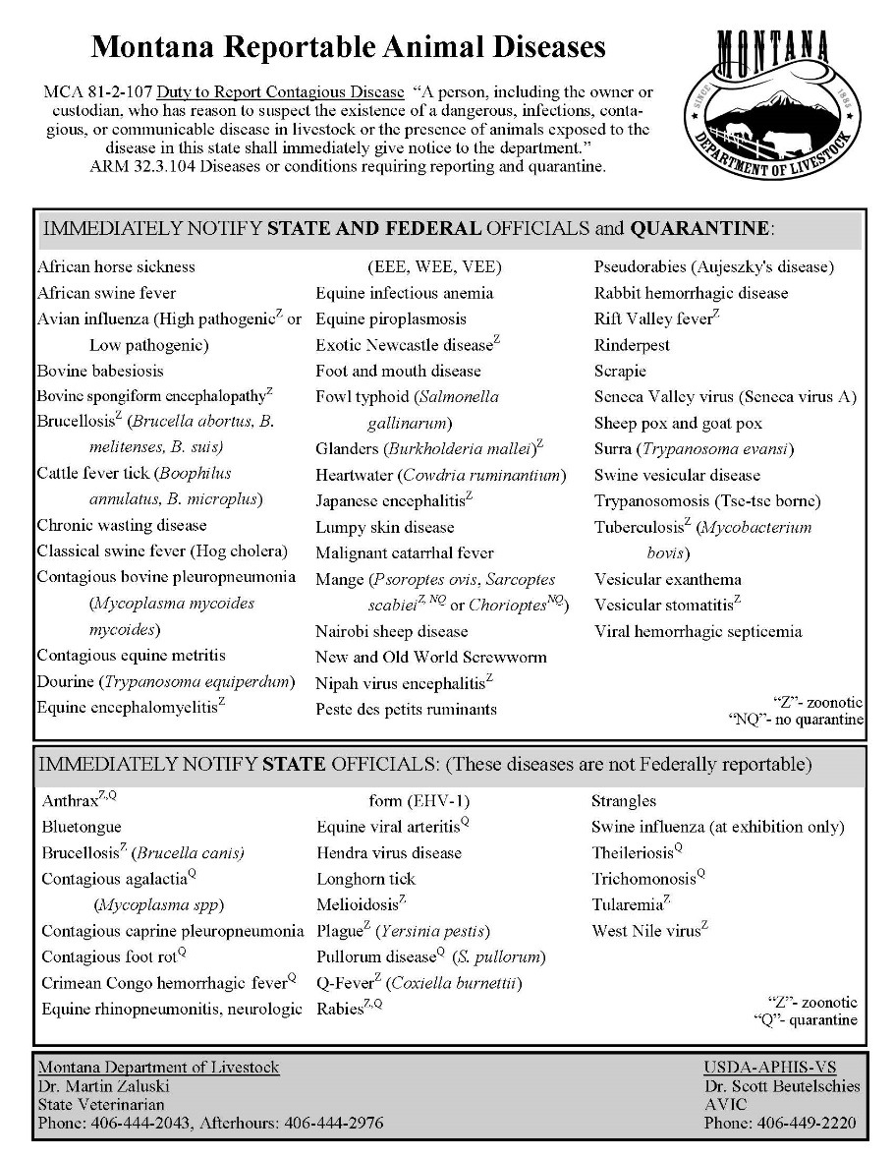
Diseases requiring IMMEDIATE reporting!
May be reported to either the state or federal office.
A verbal quarantine should be placed on premises.
Quarantine should include all susceptible species.

Slide 12
Quarantines
3 Types of Quarantines:
Epidemiologic investigation by MDOL
Conducted by MDOL/USDA on entire herd when an animal tests positive for select quarantinable diseases
Post- entry/illegal import
Issued when import requirements are not met before importing animals into MT
Can be issued by deputy state veterinarian or Brands Enforcement Officers
Import exemption quarantine
Requested by issuing veterinarian or MT producer
One of the MT state veterinarians authorize animals to enter state prior to meeting import requirements

Slide 13
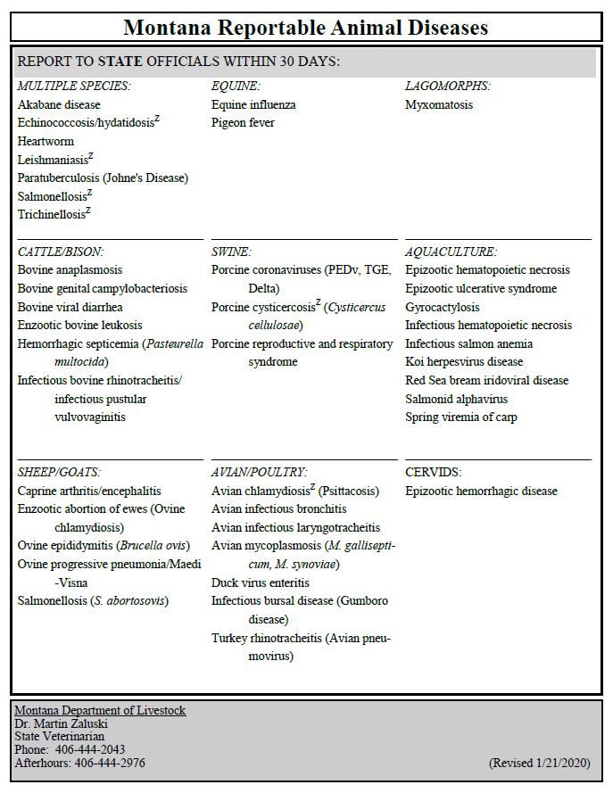
Monthly Disease Reporting
Report to state office by text, phone, fax, or email if using a diagnostic laboratory other than the Montana Veterinary Diagnostic Laboratory (MVDL).

Slide 14
Please remember…
Only submissions through the MVDL are automatically reported to our office.
If you are using an alternate laboratory or are doing in house diagnostics, you must notify our office when a reportable disease is diagnosed.
The reportable disease list
is dynamic. Additions/removals
based on feedback.

Slide 15
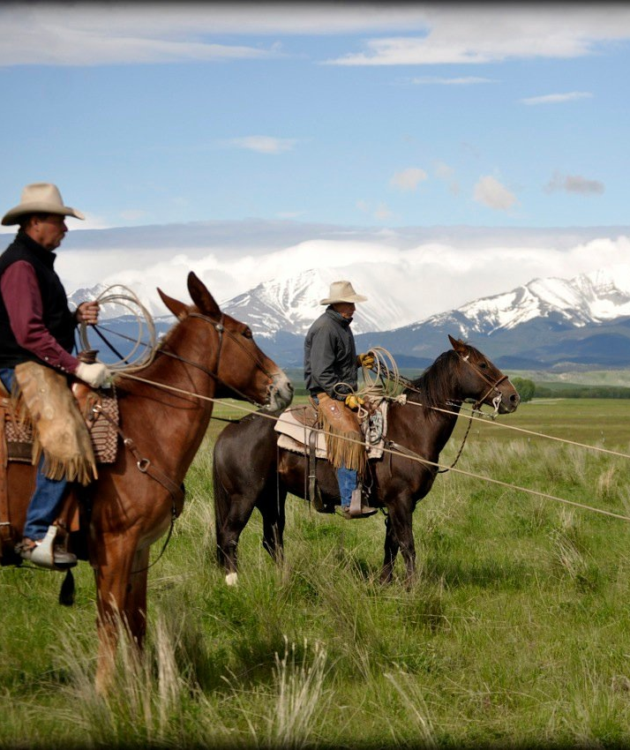
In the Past 24 months…
Brucellosis
Johne’s
West Nile virus
Rabies
EHV-1
CAE
Avian Influenza
Brucella canis
Strangles
Chronic Wasting Disease
Rabbit Hemorrhagic Disease
Tuberculosis
EEE

Slide 16
Rabies
Montana law references the Compendium of Animal Rabies Prevention and Control (2016).

Slide 17
Management of rabies
10 days |  | Quarantine for dogs, cats, and ferrets that expose humans.
28 days |  | Protective immune response following initial vaccination.
45 days |  | Observation period for vaccinate exposed to a rabies positive animal.
60 days |  | Length of county quarantine following positive terrestrial rabies case.
120 days |  | Quarantine for non-vaccinates exposed to a positive, unsuitable, or unavailable animal.

Slide 18
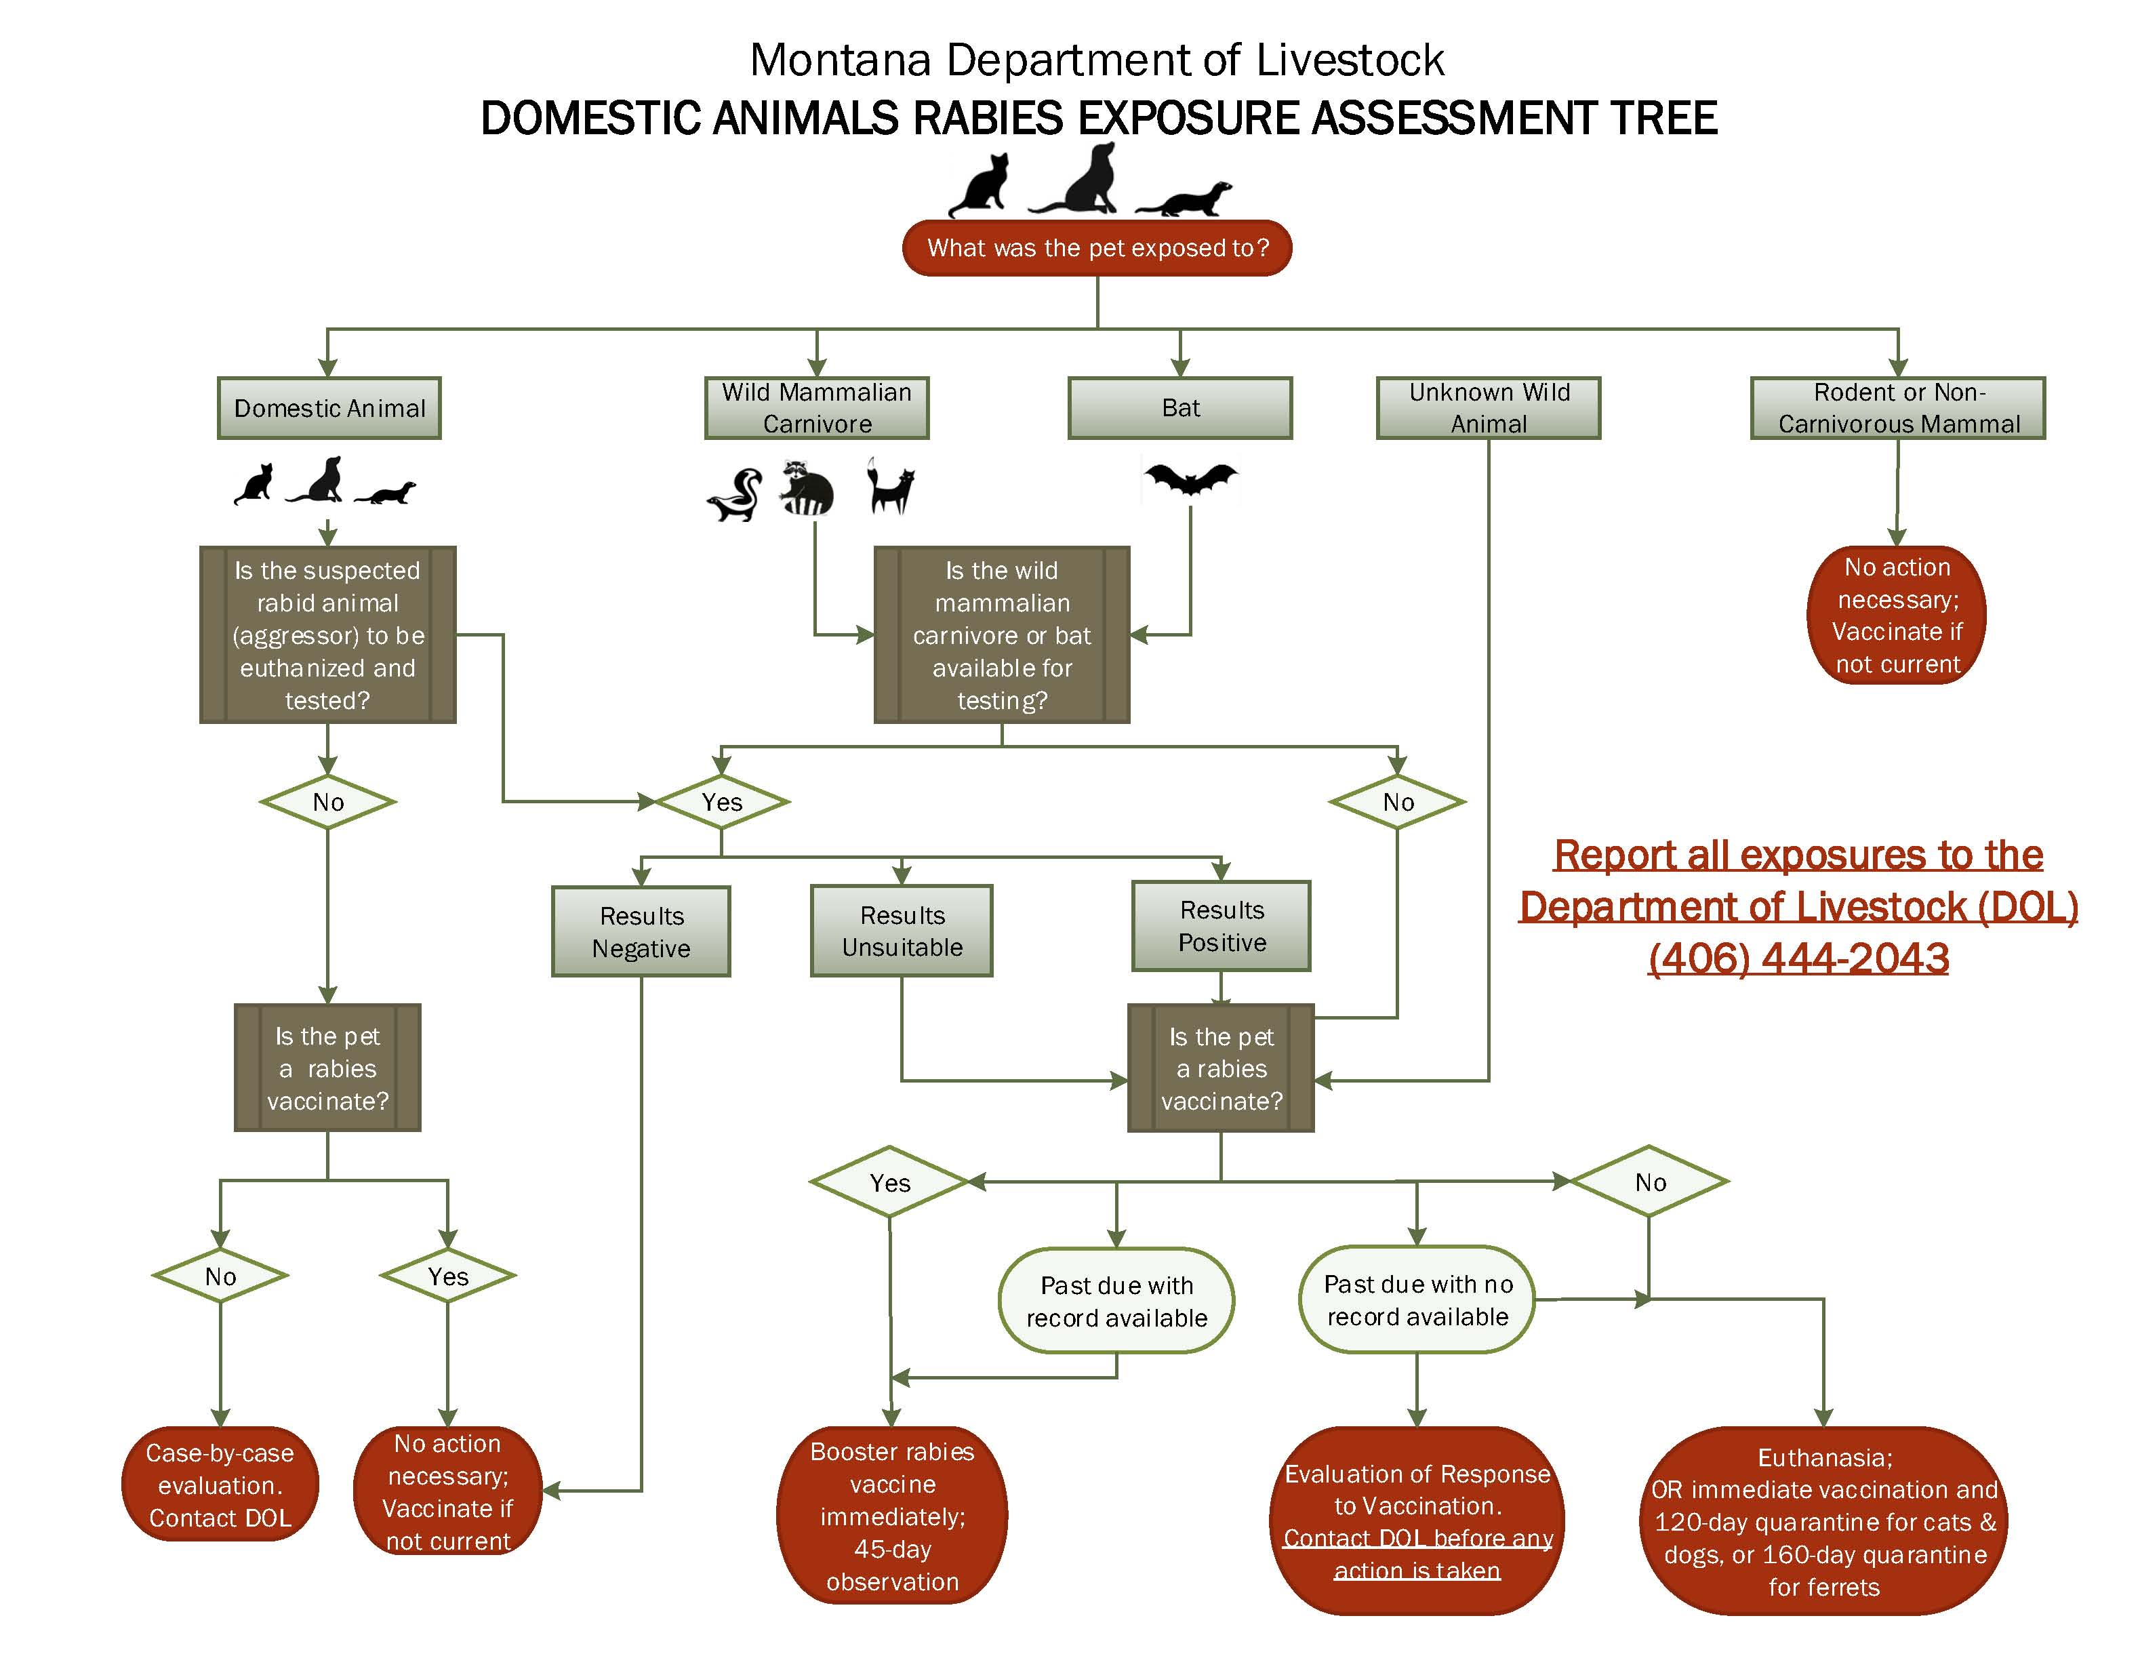

Slide 19
What is the veterinarian’s role?
Education
45-day observation period
60-day county quarantine
Vaccination
4-month quarantine
Contact DOL
Vaccination of animal at beginning of quarantine period
Mid and Final examination of animals under quarantine
Communication with and education of client
Mandatory Reporter
37.114.201 …any person, including, but not limited to a physician, dentist, nurse, medical examiner, other health care practitioner, administrator of a health care facility or laboratory, public or private school administrator, or laboratory professional who knows or has reason to believe that a case exists of a reportable disease or condition defined in ARM 37.114.203 must immediately report to the local health officer the information specified in ARM 37.114.205(1) and (2).

Slide 20
Human Exposure
MDOL and DPHHS will work with the individual, the local veterinarian, animal control, and local public health officials to determine case management.
Human bitten by animal:
Contact public health +/- animal control
37.114.203 Reportable Diseases and Conditions (at) Rabies in a human or animal; exposure to a human by a species susceptible to rabies infection…
10-day quarantine regardless of vaccination status
Do not vaccinate during 10-day quarantine
Do not euthanize animal without permission & without testing!

Slide 21
Vaccination
No state law requiring rabies vaccination
Vaccination requirements are set by city and county ordinances
Vaccination certificates should be consistent with the vaccine label

Slide 22
Can someone other than you administer the rabies vaccination?
32.3.2301 CONTROL OF BIOLOGICS
(5) The sale of any rabies biologic except to a licensed veterinarian or public health agency is prohibited.
Compendium of Animal Rabies Prevention and Control, 2016
Preexposure vaccination and management. Adherence to a regular rabies vaccination schedule is critical to protect animals against recognized and unrecognized rabies exposures. Parenteral animal rabies vaccines should be administered only by or under the direct supervision of a licensed veterinarian on premises. Rabies vaccines may be administered under the supervision of a licensed veterinarian to animals held in animal shelters before release.33,34 The veterinarian signing a rabies vaccination certificate must ensure that the person who administered the vaccine is identified on the certificate and has been appropriately trained in vaccine storage, handling, and administration and in the management of adverse events. This ensures that a qualified and responsible person can be held accountable for properly vaccinating the animal

Slide 23
Certificate of Veterinary Inspection (CVI)
Health Certificate

Slide 24
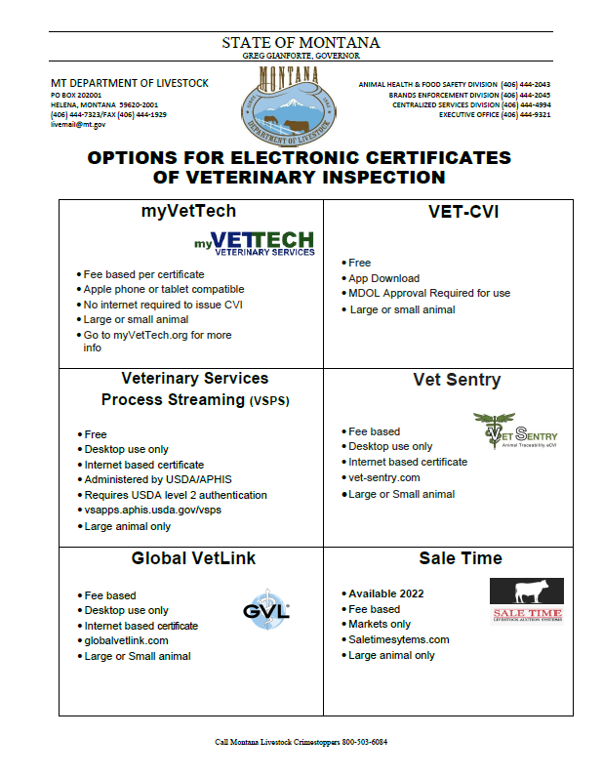

Slide 25
Certificate of Veterinary Inspection
ICVIs MUST INCLUDE THE FOLLOWING INFORMATION:
Species covered
Number of animals in shipment
Purpose for movement
Physical address from which animals originated
Physical address that animal are destined to
PO Boxes are not an acceptable address
Name and address of consignor and consignee (if different)
Official identification must be recorded for animals required to be officially identified

Slide 26
Certificate of Veterinary Inspection
Examination/inspection of animals MUST be performed within 10 days prior to date of issuance unless monthly visits conducted.
Valid for 30 days from the date of inspection.
Required for out of state travel and some in-state exhibitions/shows.
Must meet state of destinations import requirements.
Animals returning to MT must meet our import requirements – potential impact to sporting bovine movements.

Slide 27
Certificate of Veterinary Inspection
Fill out CVI completely and legibly, this is a legal document.
Document all exemptions or special instructions including the name of person giving information.
Accurately describe the age, gender, species, color and official ID of all animals on shipment.
Verify test results.
Do NOT re-tag animals with existing official ID (Bangs tags, silver USDA tags, Scrapie or RFID tags).
Obtain all required permits:
State of destination import permit if applicable.
Montana re-entry permit if applicable.
Sign and date the form.

Slide 28
Interstate Movement Prohibited
Equine/ bovine piroplasmosis
Anthrax
Cattle scabies
Pseudorabies
Acute swine erysipelas
TB
See 9CFR 71.3
Johne’s Disease
Brucellosis
Scrapie
Bluetongue
Chlamydiosis
Salmonella enteritidis serotype enteritidis
Newcastle Disease

Slide 29
eeCVI
Extended equine Certificate of Veterinary Inspection
Good for 6 months from date of Coggins blood draw.
Obtained through Global Vet Link.
Owners must report each movement.
Cannot be used for movement of mares and stallions for breeding purposes.

Slide 30
Illegal Imports
As a DSV you have quarantine authority in MT for animals who have entered without meeting import requirements.
Verbal or written.
Information must be relayed to MDOL.
Quarantine animals until requirements have been met and/or post illegal permit number is obtained from MDOL.
Complete:
Required testing/vaccination
Call MDOL for post illegal permit number with the following information:
1. origin address
2. destination address
3. animal details (species, sex, breed, age, identification)

Slide 31
Traceability

Slide 32
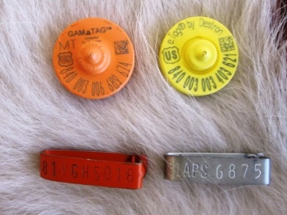
Traceability - The Basics
Official individual identification required* for interstate movement:
All sexually intact cattle and bison 18 months of age and older
All dairy cattle
All animals for exhibition/sporting
M branded cattle*
Unless moving…
To an approved tagging site
Between two states that have agreed upon alternate form of identification
Direct to slaughter.
To an approved livestock facility and then direct to slaughter.
*Please note, cattle and domestic bison originating from Montana's DSA have additional identification requirements.

Slide 33
The Basics (cont.)
All cattle and bison moved interstate require a certificate of veterinary inspection (CVI).
Unless moving…
Direct to slaughter
To approved livestock facility and then direct to slaughter
Farm of origin to approved livestock facility
For animals required to be officially identified, ID must be listed on the CVI, unless:
Montana requires that 90% of listed tag numbers represent animals included in the shipment.
Notes:
Always check with state of destination for state specific requirements. For example… Montana requires identification on additional classes of cattle and bison.

Slide 34
The Basics (cont.)
Double tagging is not allowed, except:
Second ear tag with same official identification number
In specific cases when the need to maintain the identity of an animal is intensified (international export, quarantined herds, experiments…)
Application of an 840 tag to an animal with an existing NUES tag, with both tags being initially recorded
Brucellosis vaccination tag to an animal previously identified, with both tags being initially recorded
If multiple forms of identification are present, they must all be recorded.
Notes:
Always check with state of destination for state specific requirements. For example… Montana requires identification on additional classes of cattle and bison.

Slide 35
Sheep and Goat Identification Requirements
When required:
For which classes:
Importation
Entry into interstate marketing channels
Change of ownership
Exhibition
Sexually intact sheep and goats, regardless of age
All sheep and goats over 18 months of age
All scrapie-suspect and test positive
All scrapie-exposed and high-risk

Slide 36
Responsibilities
Accredited Veterinarian
Animal Health Official
Knowledge of and compliance with regulations
Records retention
Tag application
CVIs
Timely submission of documents
Vaccination certificates
CVIs
Education
Realistic expectations
Facilitation
Records management
Ability to trace animals

Slide 37
Records Management
AKA Those pesky silver metal clips!!!
Notes:
Vaccination tags: S, T, and V

Slide 38
Records Management - Tags
What is required:
What we expect:
Don’t lose
Report if lost/transferred
Record sufficient contact information, including:
Owner
Address
Tag range applied
Date of application
5 years
Notes:
Basically, to determine when, where, and to whose cattle a tag was applied should not require flipping through every CVI issued for the last 6 months!

Slide 39
Records Management - Tags
Electronic templates available
Potential exists for reporting to MDOL

Slide 40
Brucellosis

Slide 41
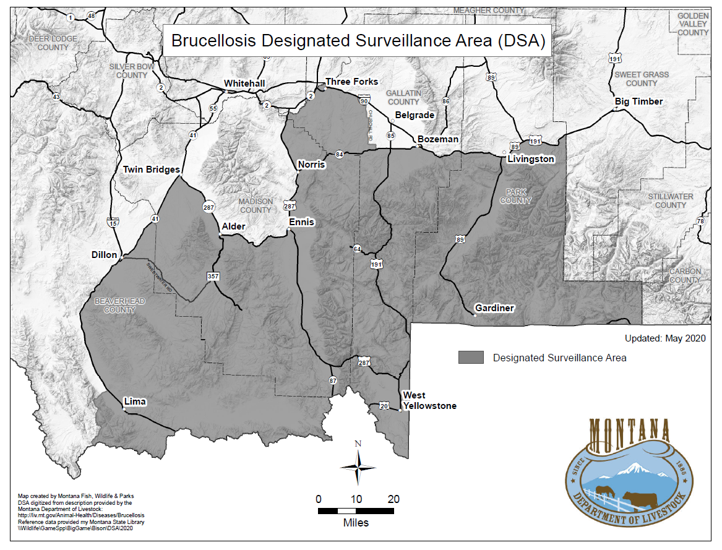

Slide 42
DSA/brucellosis regulations
Movement testing
Bulls and females 12 months of age and older
Change of ownership testing
Bulls and females 12 months of age and older or any age if sold for breeding purposes
Brucellosis vaccination required
-All females 12 months of age and older
-Official Calfhood Vaccination (OCV) or Adult Vaccination (AV)
Traceability-official I.D. required
All bulls and
females (includes feeder heifers <12 months of age)
-10 Counties that contain or border on the DSA or Wyoming’s Brucellosis Area of Concern

Slide 43
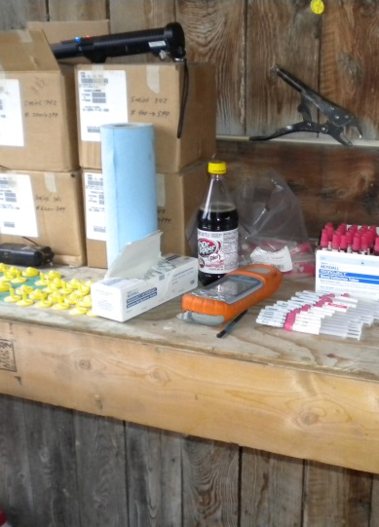
32.3.435 TESTING
ALL test eligible animals and cattle or domestic bison of any age if intended to be used for breeding purposes that are or have been within the DSA:
A test within 30 days prior to movement out of the DSA or change of ownership, unless going to an approved Montana livestock market or directly to a slaughter.
A test July 16th or after is acceptable for movement out of the DSA or change of ownership through February 15 of the following year.

Slide 44
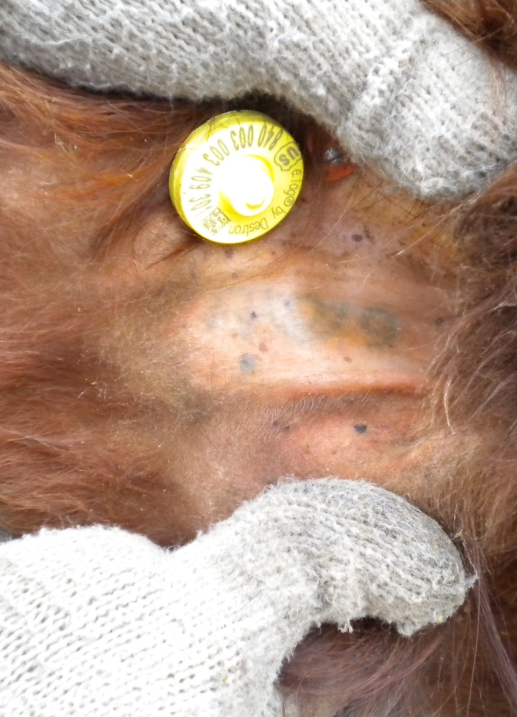
32.3.436 VACCINATION
Within the entirety of counties in which the DSA is located-all sexually intact female cattle and domestic bison that are four months of age or older as of January 1 of any year must be Official Calfhood Vaccinates (OCV).

Slide 45
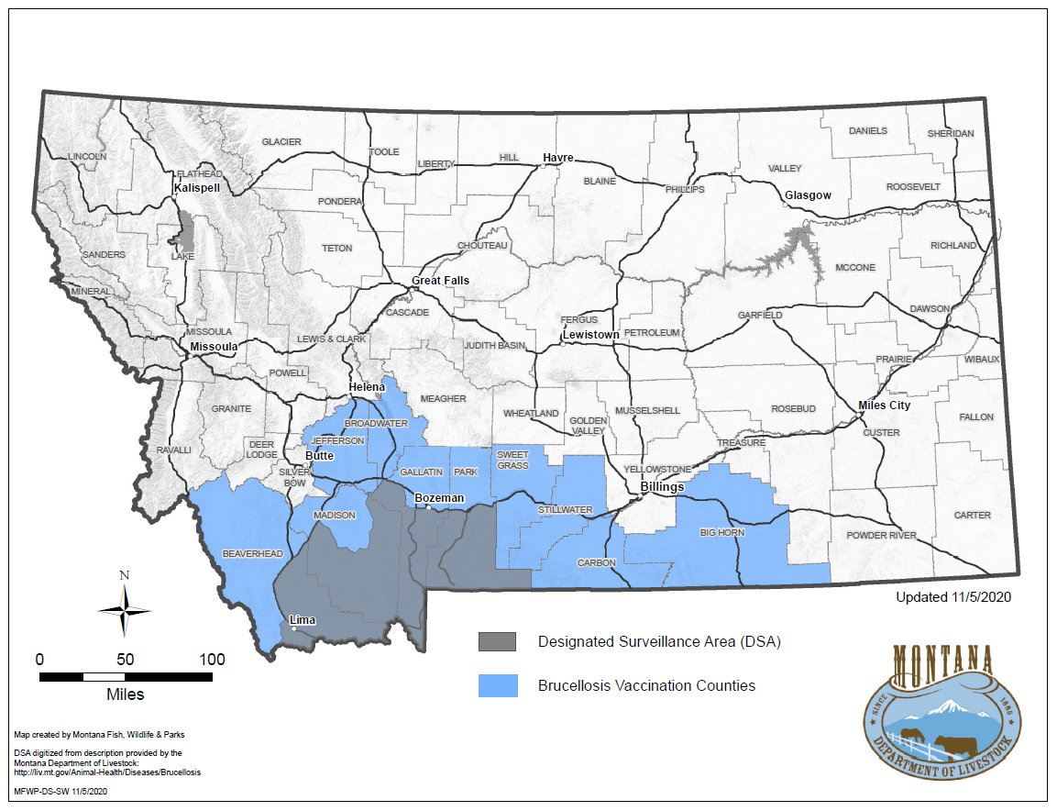

Slide 46
SV-2E
Hardware: | N/A | Software: | Excel | Cost: | $0 | Internet: | No

Slide 47
32.3.434 IDENTIFICATION
All sexually intact cattle and domestic bison leaving the DSA must be identified with official individual identification.
If writing a CVI on animals leaving the DSA, always check with the state of destination for state specific requirements.

Slide 48
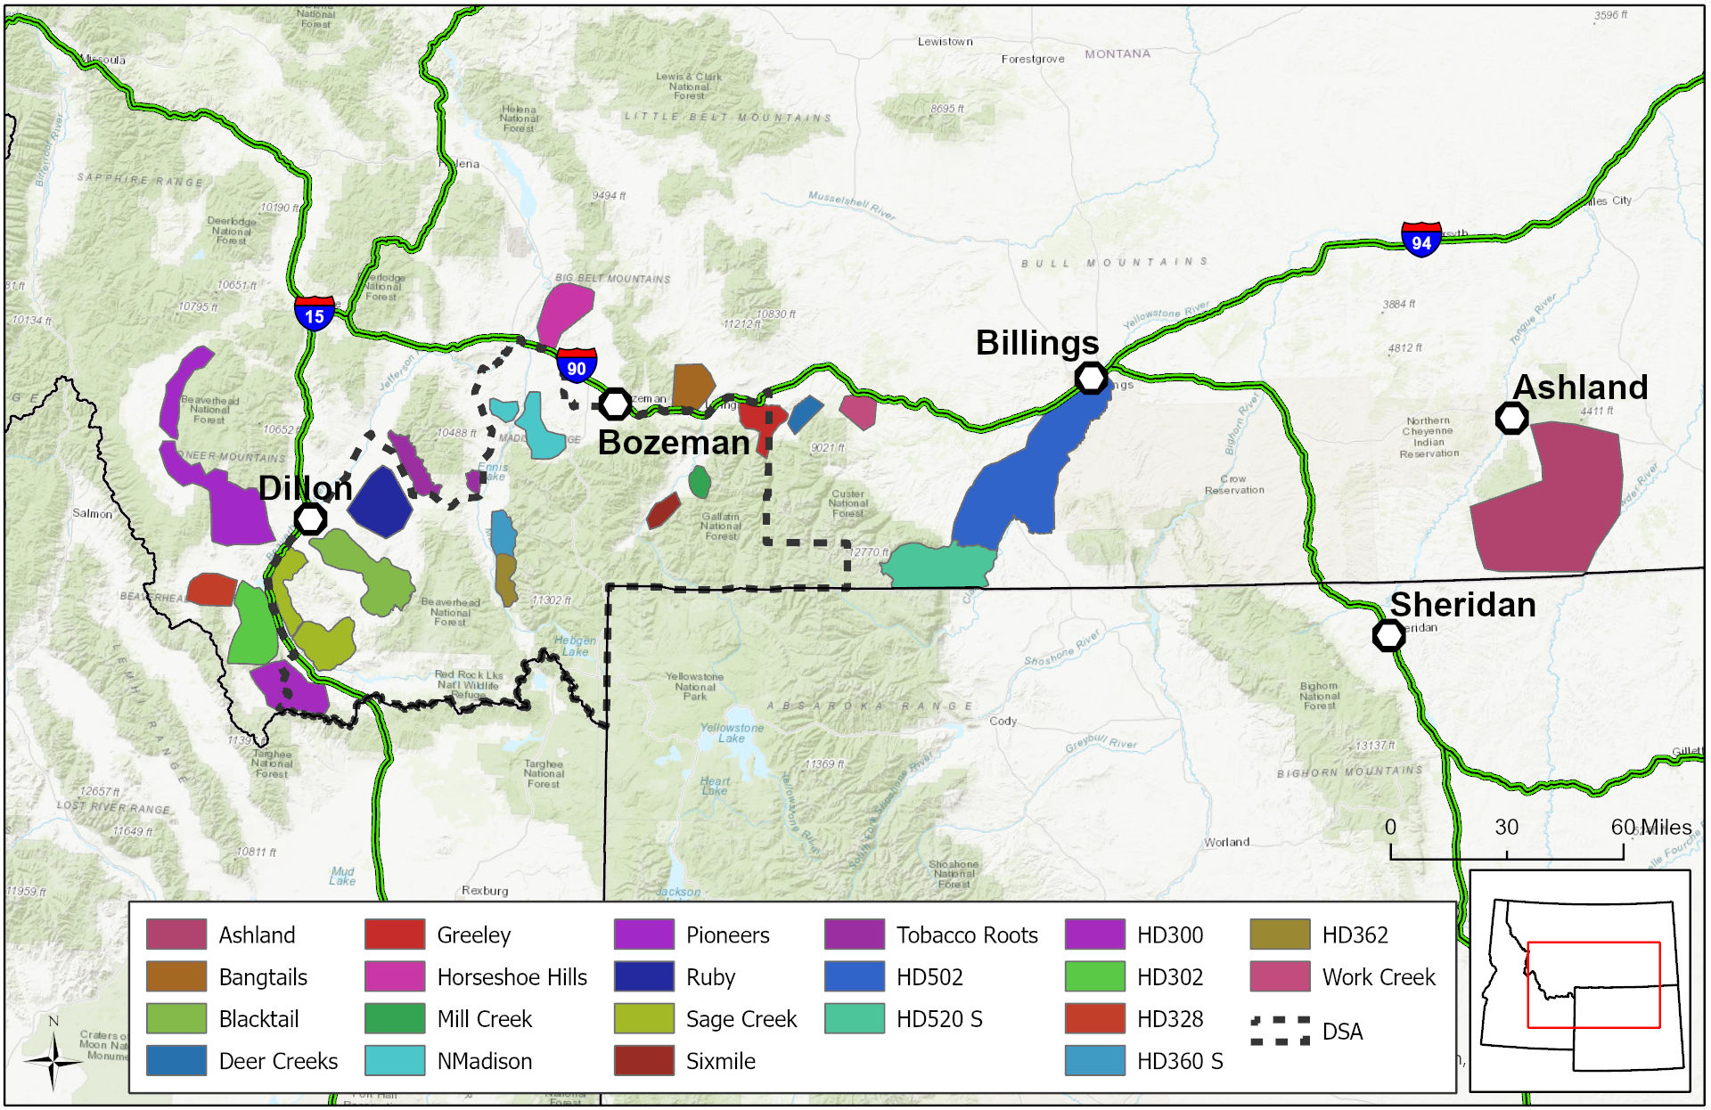
Wildlife Surveillance

Slide 49
Trichomoniasis

Slide 50
Trichomoniasis in MT:
Reportable and Quarantinable
Program outlines:
Trichomoniasis Epizootic Area (Trich EA)
Testing requirements
Management of positive animals and herds
Import requirements
Penalties

Slide 51
Trichomoniasis Epizootic Area (EA):
Negative test required for:
All non-virgin bulls sold, loaned, or leased within or from the EA.
All non-virgin bulls inspected out of the EA, including animals for change of pasture.

Slide 52
Statewide Test Requirements:
Non-virgin bulls from multiple sources going to a common pasture for breeding
Exception: Herds with an approved herd health plan on file with MDOL. Herd health plan must include:
Best management practices
A base line negative test of all non virgin bulls grazing in common
A negative test of all newly acquired non-virgin bulls
Non-virgin bulls imported into Montana.
Exceptions: Sporting bovine, CAN origin exhibition, animals imported into CSS certified Bull Semen Collection facilities.

Slide 53
Virgin Bull:
<12 months of age
12-24 months of age with an owner signed affidavit of virginity
If you are testing bulls for out of state movement, please check state of destination requirements!

Slide 54
Official Testing:
Deputy state veterinarian ONLY
Minimum 2 weeks sexual rest prior to test.
Minimum 1 week interval between multiple tests.
Test good for 60 days or immediately upon commingling with female cattle
Must be performed at an AAVLD accredited laboratory.
Preferred labs for PCR testing include:
MDOL Veterinary Diagnostic Lab
CSU Veterinary Diagnostic Lab
Wyoming State Veterinary Lab

Slide 55
Official Testing:
Preputial scraping ONLY
3 negative weekly cultures
95% sensitivity
NOT Specific for T. foetus
PCR (DNA test)
Specific for T. foetus
97% sensitive and specific if sample is properly collected on positive samples.
Pooling of samples is now acceptable except for:
Known positive herds
Epidemiological investigation testing
Some interstate movements

Slide 56
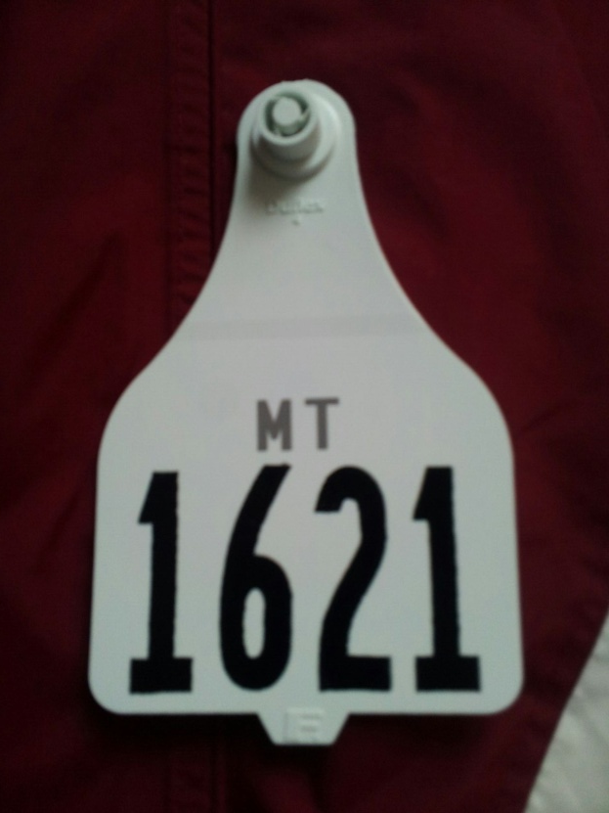
Identification Requirements:
At the time of a bull’s first trich test, a MT trich tag or other approved official individual id tag must be applied.

Slide 57
Montana Johne’s Control Program

Slide 58
Program Background and Goals
DOL has received inquiries from buyers of MT cattle for a “list of producers” who have tested for Johne’s Disease
Cases of MT seedstock producers selling Johne’s positive cattle
DOL looking for participation from seedstock, commercial and dairy herds
Not focused on herds known to have had a positive animal in the past
Producers can advertise/market their participation
Will require industry buy-in
“A positive, managed herd is lower risk than a herd with an unknown status”

Slide 59
Program Components
Education
Herd Management Plan
+/- testing

Slide 60
Education
Herd veterinarian will educate the producer, using information provided by DOL
Basic disease information
Management strategies
Testing options
Different ways to participate in the program

Slide 61
Herd Management Plan Classification Levels
0- Unmanaged Risk
2- Managed Risk
3- Assurance
4- High Assurance
1- Evaluated Risk

Slide 62
0-Unmanaged Risk
No actions taken towards management of Johne’s risk or spread
No herd management plan in place
0- Unmanaged Risk
2- Managed Risk
3- Assurance
4- High Assurance
1- Evaluated Risk

Slide 63
1-Evaluated Risk
Herd management plan completed
Clinical +/- test positive cases removed or separated from high-risk group cattle
+/- testing on high-risk group cattle
Animals showing clinical signs
Offspring of positive dams
0- Unmanaged Risk
2- Managed Risk
3- Assurance
4- High Assurance
1- Evaluated Risk

Slide 64
2-Managed Risk
Completed all requirements of Level 1 including:
Herd Management Plan
Testing completed on all cattle > 2 years of age
Clinical and positive test cases removed
0- Unmanaged Risk
2- Managed Risk
3- Assurance
4- High Assurance
1- Evaluated Risk

Slide 65
3-Assurance
Completed all requirements of Level 2 including:
Herd management Plan
Annual testing on all cattle >2 yrs. of age
Clinical and positive cases removed
Two years since clinical or positive test case
0- Unmanaged Risk
2- Managed Risk
3- Assurance
4- High Assurance
1- Evaluated Risk

Slide 66
4-High Assurance
Completed all requirements of Level 3 including:
Herd management Plan
Annual testing on all cattle >2 yrs. of age
Clinical and positive cases removed
Five years since clinical or positive test case
0- Unmanaged Risk
2- Managed Risk
3- Assurance
4- High Assurance
1- Evaluated Risk

Slide 67
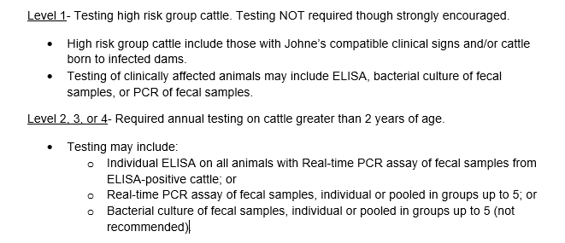
Testing
Please note, all samples must be collected by or under the supervision of an accredited veterinarian, an animal health official, or authorized testing agent (employee of the DOL)

Slide 68
Additional Information
Purchasing a classified herd
Appealing the status of a test-positive animal
Use of embryo transfer
Herd additions
Herd additions from other states

Slide 69
Renewal
Owner and veterinarian must review and update the Herd Management Plan annually
A copy of test results must also accompany the herd management plan

Slide 70
Reminder: Johne’s Regulations
Johne’s is a reportable disease in Montana per Administrative Rule of Montana (ARM) 32.3.104
Johne’s positive animals are not subject to quarantine
There are federal restrictions on the movement of positive animals across state lines
Title 9, Code of Federal Regulations (9 CFR), part 71
Animals that are positive to an official Johne’s test may generally be moved interstate only to a recognized slaughtering establishment or to an approved livestock facility for sale to such an establishment
The animals must bear an official ear tag and be shipped with an owner-shipper statement

Slide 71
Miscellaneous
Biologics
Tuberculin
Anthrax
Autogenous vaccines
NPIP
Avian Influenza Surveillance
Form orders

Slide 72
Any Questions???
Tahnee Szymanski
Assistant State Veterinarian
406-444-5214

